Slide 1

Health Canada -2 (Sante Canada) Data Integration Dashboard By Capstone Group 6
Supervision by:- Professor Prableen Singh

Slide 2
Role&Responsibility
Saket Mahar(TL)
Ankit Kumar Gamechi
Project Manager
DATA Visulization
Sai Akhil
Alis Findoliya
Documentation
DATA Generation

Slide 3
INTRODUCTION
This project focuses on seamlessly integrating human resources (HR), financial, and asset management data to develop interactive dashboards tailored for the management team. These dashboards will serve as powerful tools in the decision-making process, providing clear and actionable insights into trends and patterns over time. By centralizing key data streams, we aim to enhance the management team's ability to make informed, strategic decisions that drive organizational success.

Slide 4

OBJECTIVES & GOALS
Integration of Data
Development of Dashboards
Centralization of Data
Trend Analysis
DATA Visualization
Timeline
Documentation
`

Slide 5

DELIVERABLES
INTRERACTIVE DASHBOARD
USER MANIPULATION OF DASHBOARD ELEMENTS
TREND ANAYLISIS
DOCUMENTATION

Slide 6
TOOLS & TECHNOLOGY
VISUALIZATION - POWER-BI
PROJECT MANAGEMENT - JIRA DATA GENERATION - PYTHON LIBRARIES

Slide 7
01
DATA GENERATION
During the data-generating phase, we created key information sets for Human Resources, Finance, and Asset Management. For HR, we generated data on employee demographics, job roles, and performance metrics to analyze workforce trends. In Finance, we created data on budgets, expenditures, and revenue to assess financial health. Asset Management data included details on asset acquisition, maintenance, and utilization. To ensure accuracy and efficiency, I developed a Python script to automate data generation and performed validation checks to correct inconsistencies early in the process. This approach provided a solid foundation for our analysis.

Slide 8
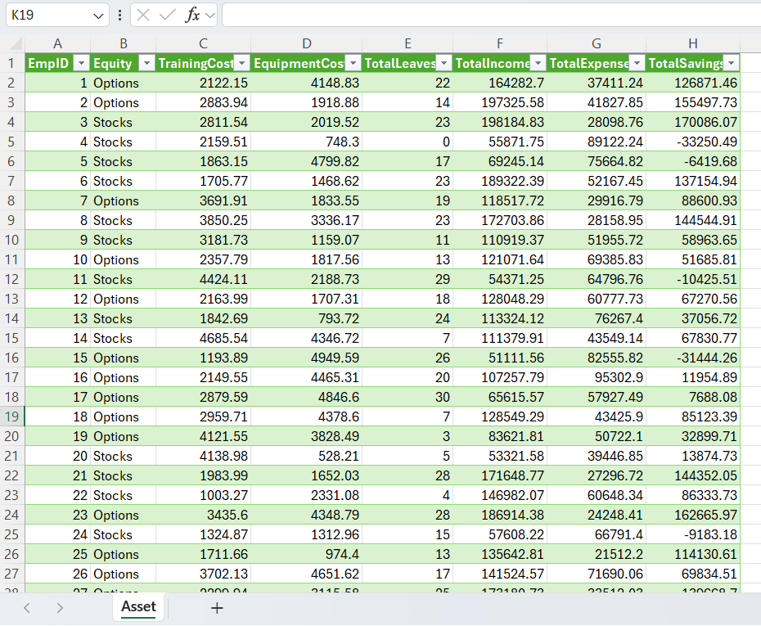
DATA GENERATION - 1

Slide 9
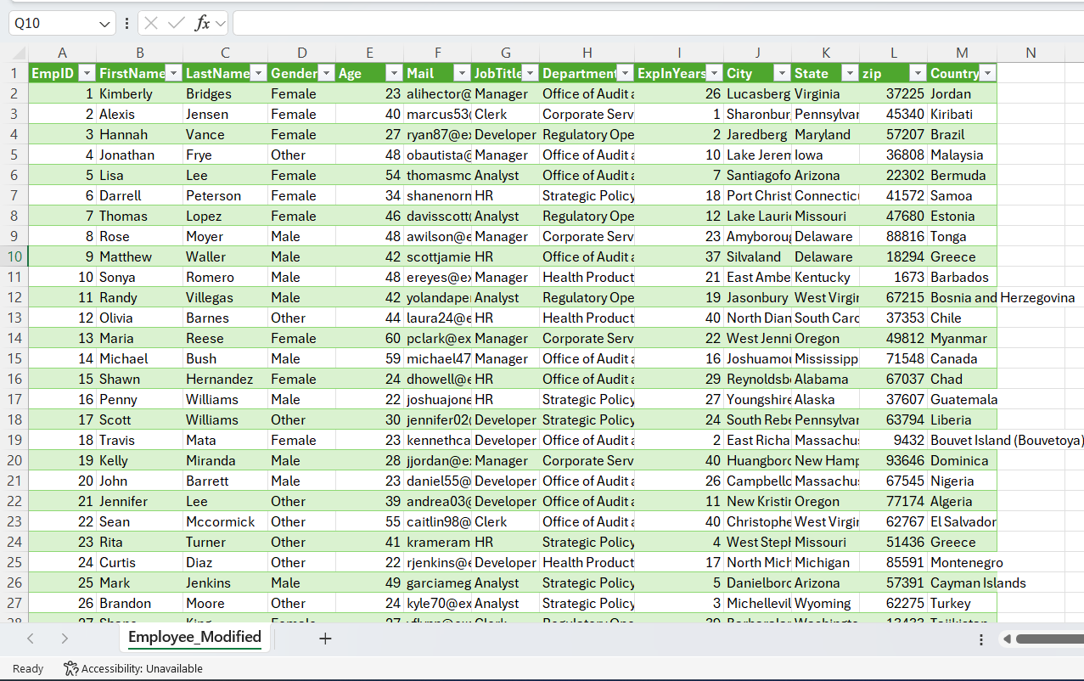
DATA GENERATION - 2

Slide 10
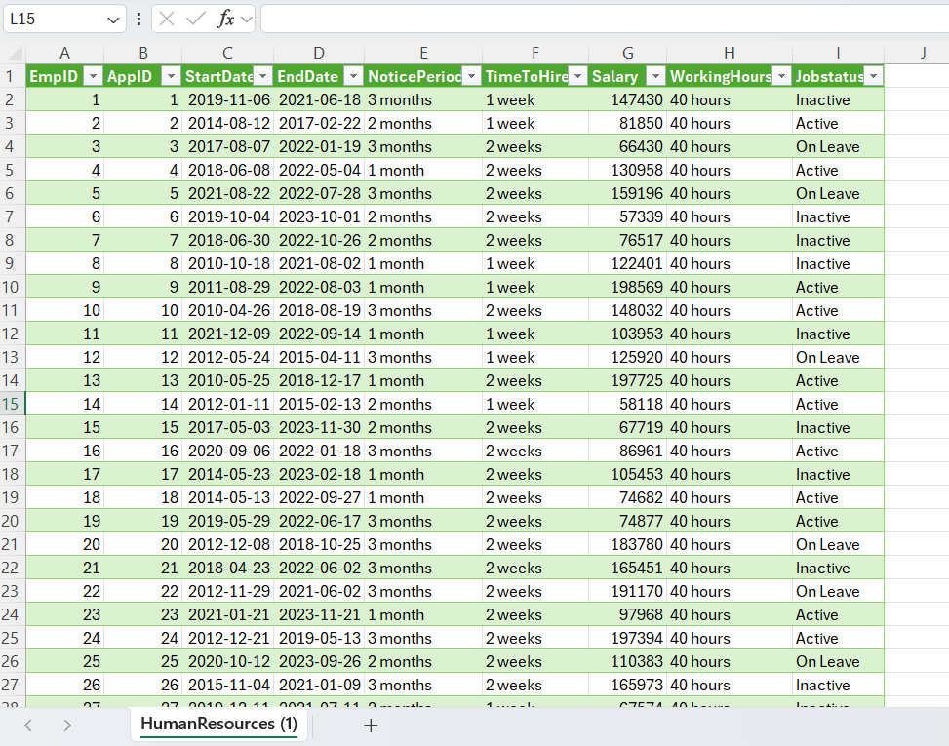
DATA GENERATION - 3

Slide 11
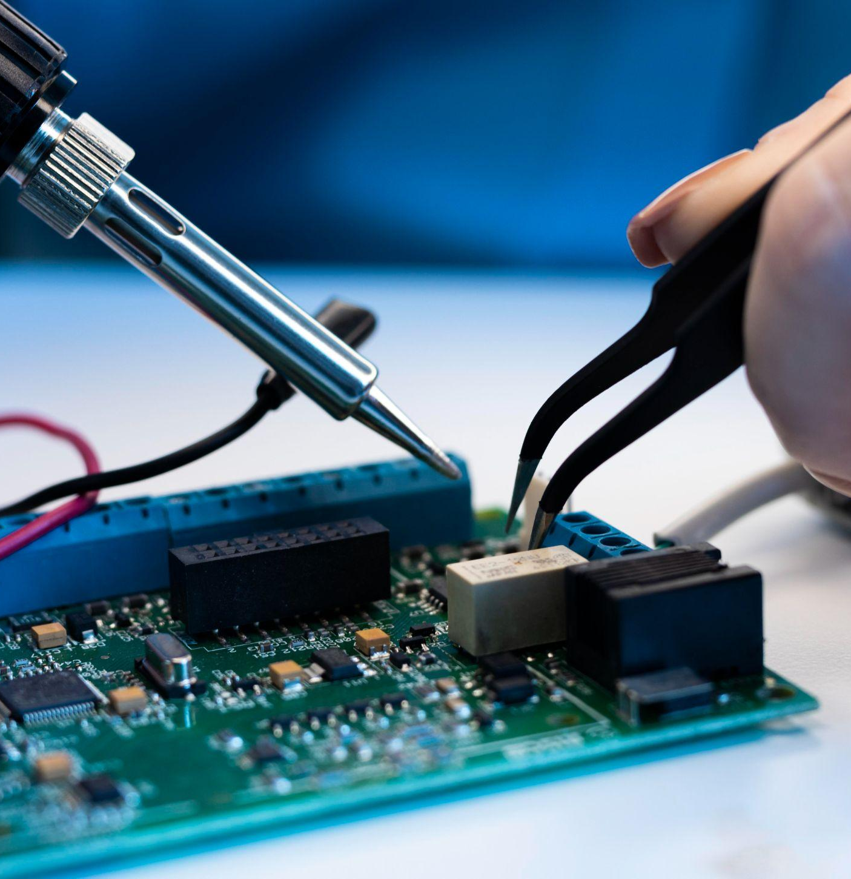
DATA MODELING
Data Normalization
Entity-Relationship Modeling
Data Transformation
Dimensional Modeling
Validation and Testing
Scalability Considerations

Slide 12
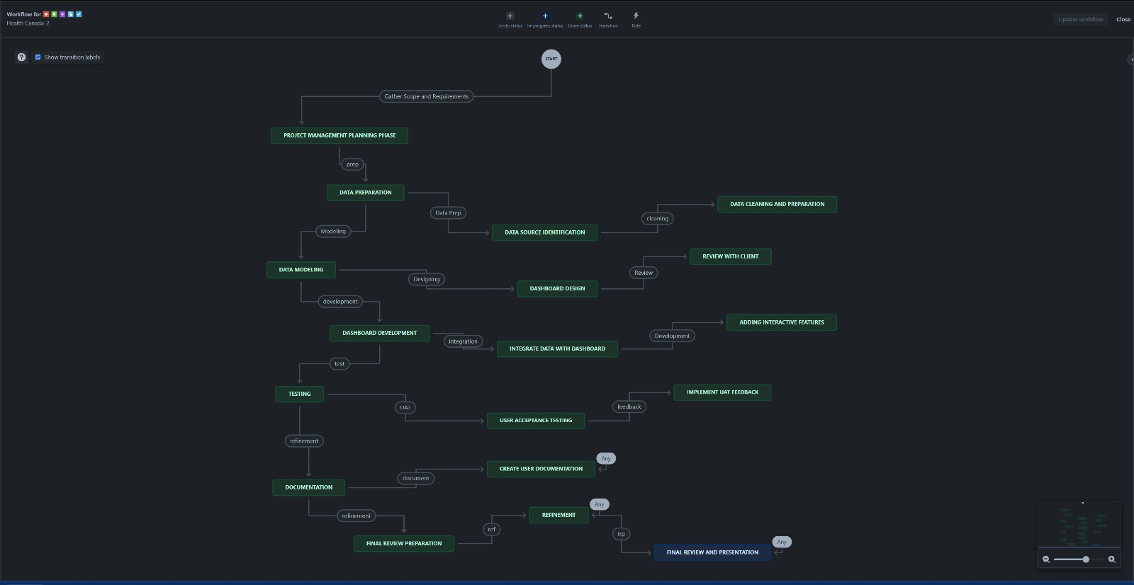
TIMELINE (JIRA)

Slide 13
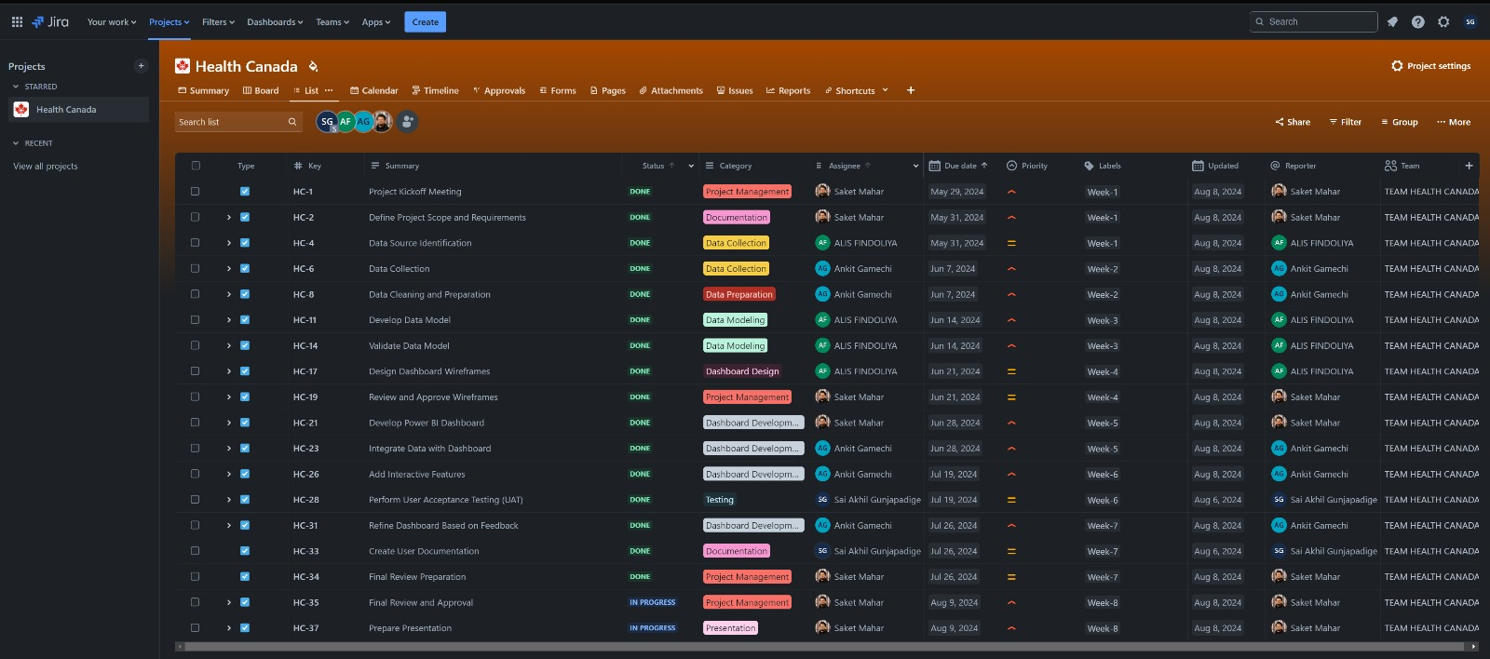
TIMELINE (JIRA)

Slide 14
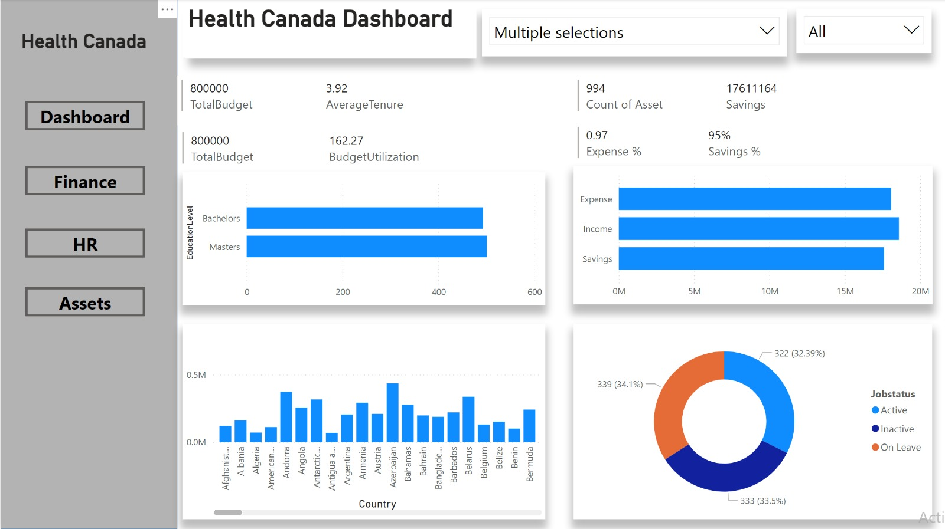
VISUALIZATION (PROTOTYPE)

Slide 15
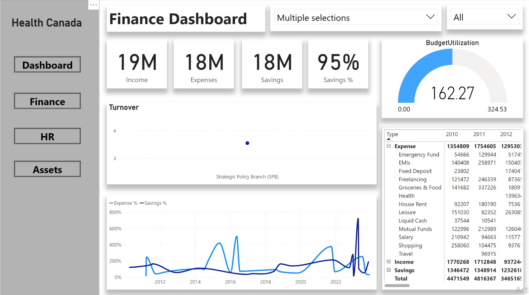
VISUALIZATION (PROTOTYPE)

Slide 16
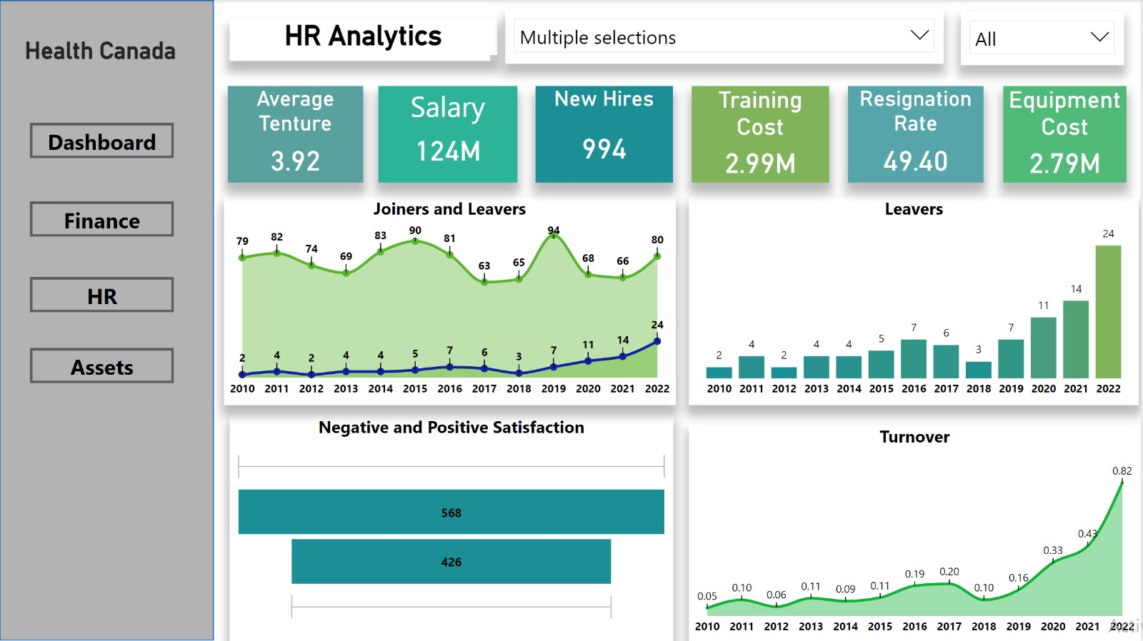
VISUALIZATION (PROTOTYPE)

Slide 17
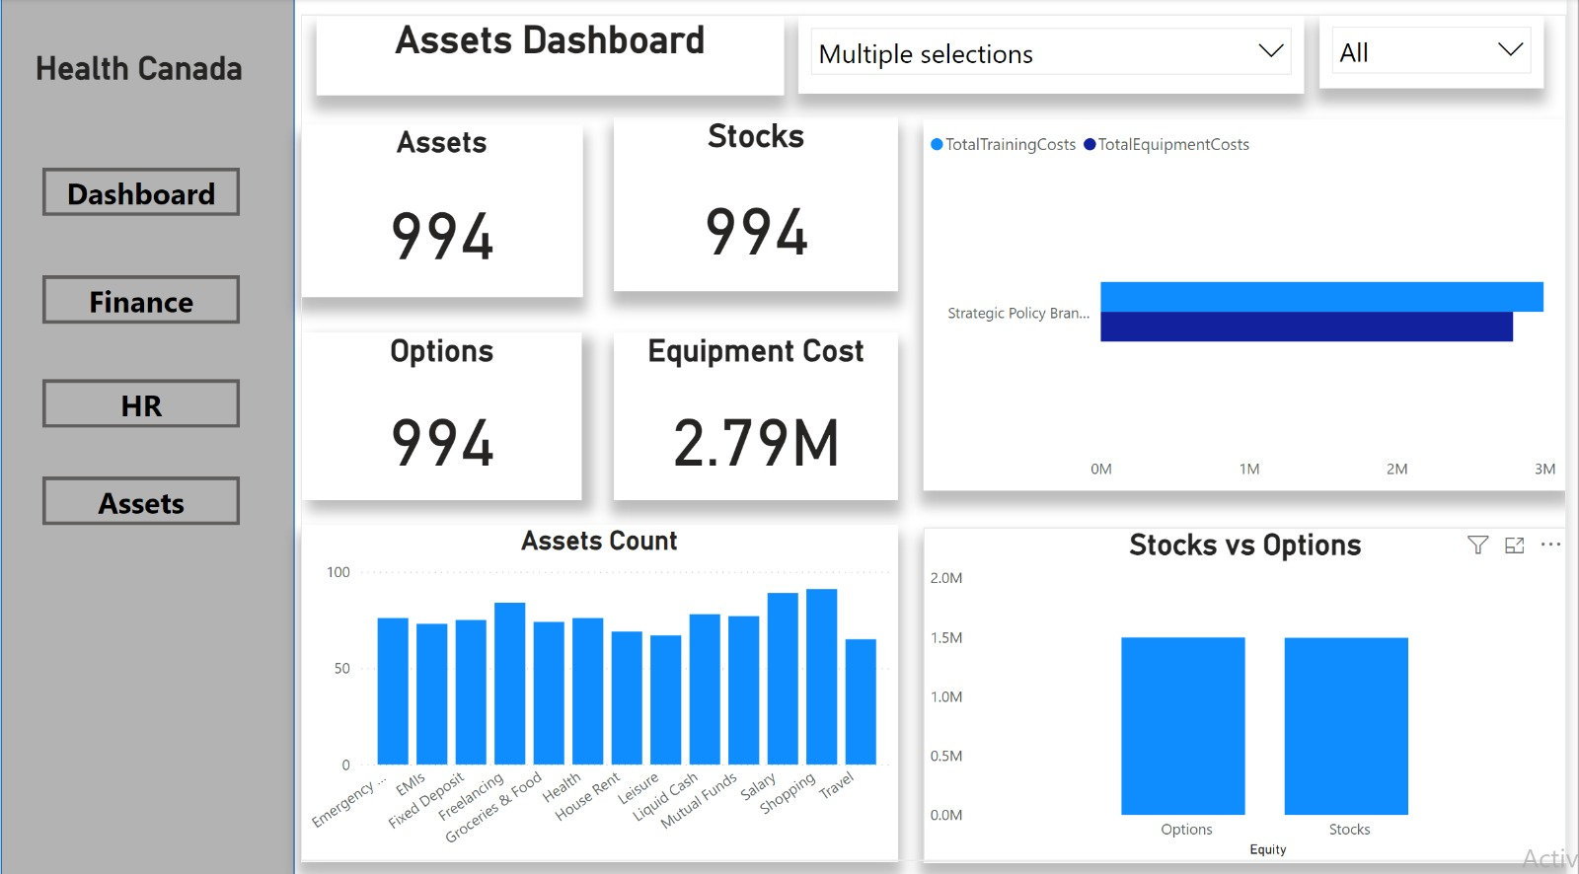
VISUALIZATION (PROTOTYPE)

Slide 18
VISUALIZATION DEMO

Slide 19
